Slide 1
Blast Vision
A System Designed for Blasting Evaluation

Slide 2
Target
&
Evaluate Blasts Qualitatively
Slungshot
Smoke
Fragmentation
Path
Value Oriented
Algorithm Driven
Project Based
Code Reusing
Parameters Optimizing
Extendibility

Slide 3
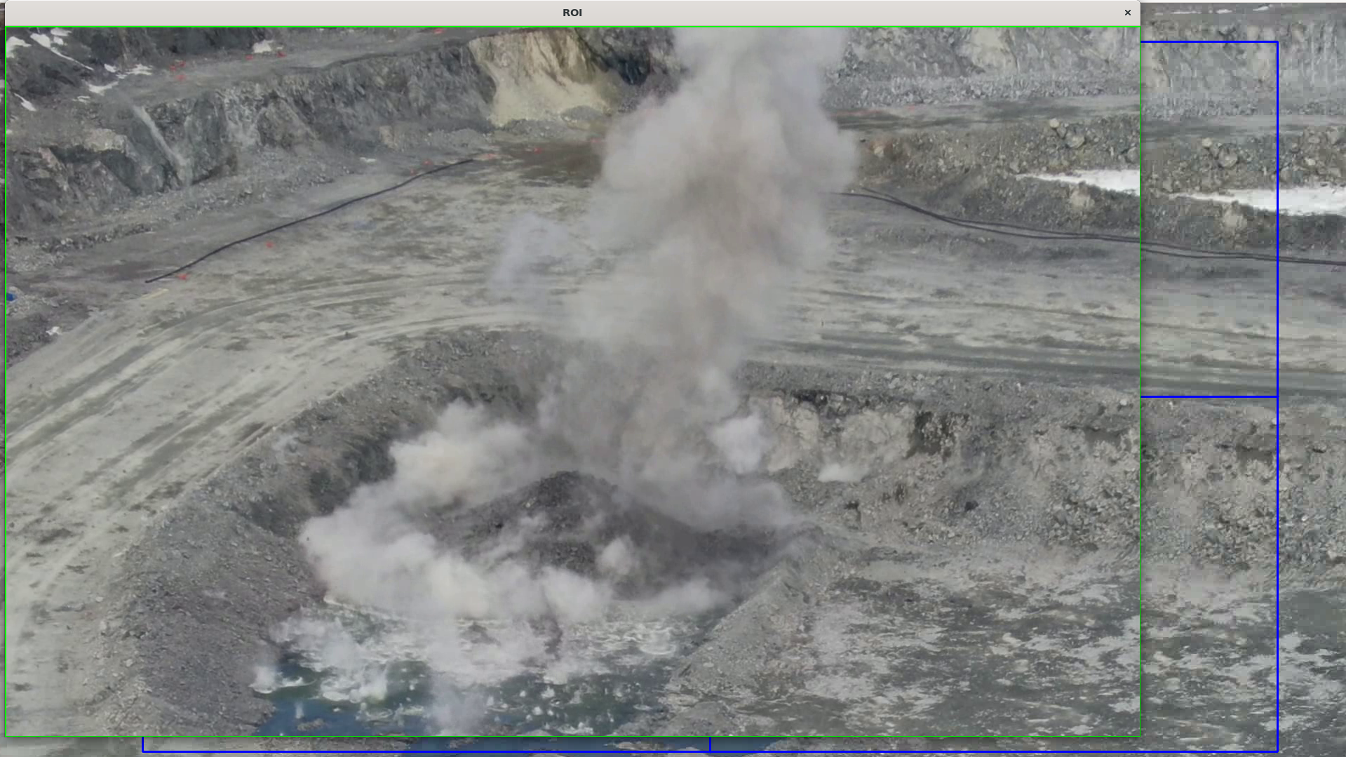
Video Preprocess
Image Enhancement
Contrast
ROI Crop
Target Tracking
Stabilization
Optical Flow
Frame Diff
VidStab lib

Slide 4
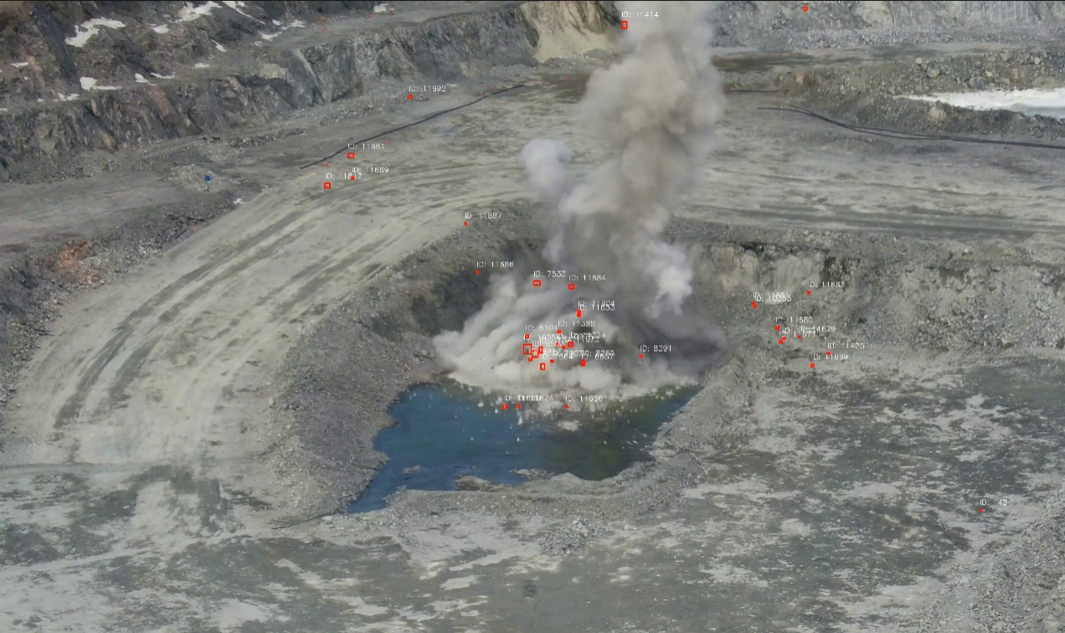
Think Before
Extracting Information from Frames of Video
Deep Learning based
YOLO V8,9,10,11
FastCNN
Classic Algorithm based
Frames Differencing
Optical Flow

Slide 5
Structure
Slungshot Analysis
Smoke Analysis
Fragmentation Analysis
Blasting Evaluation

Slide 6
Slungshot Analysis
Detection
Frames Difference
Optical Flow
Tracking
ByteTrack
StrongSORT
Results Processing

Slide 7
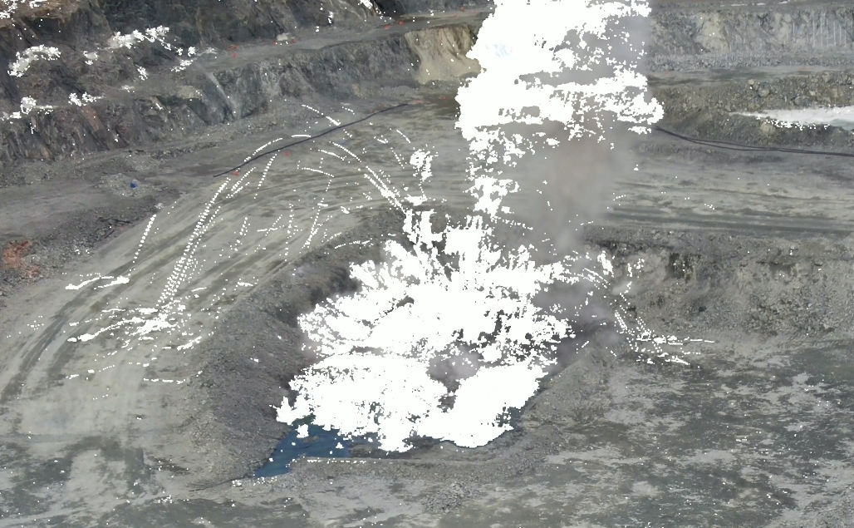
Smoke Analysis
Contour
BackgroundSubtract
Analysis
Colour

Slide 8
Fragmentation Analysis
Contour
Plain Frames Differencing
Analysis
Colour

Slide 9
Supplemental Algorithms
ECC
morphologyEX
Colour

Slide 10
We Also
Recompiled the opencv-python library to have the CUDA support and GPU acceleration.
Optical Flow
And more
Built the Web UI
Analysis management
File management and preview
ROI and shapes drawing
Real time processing monitoring

Slide 11
Improvement and Fine tuning
More Algorithms and Models introduced for
Video preprocessing
Object detection
Object tracking
Evaluation reports
And Maybe
Camera Calibration
3D modelling
A lot of things

Slide 12
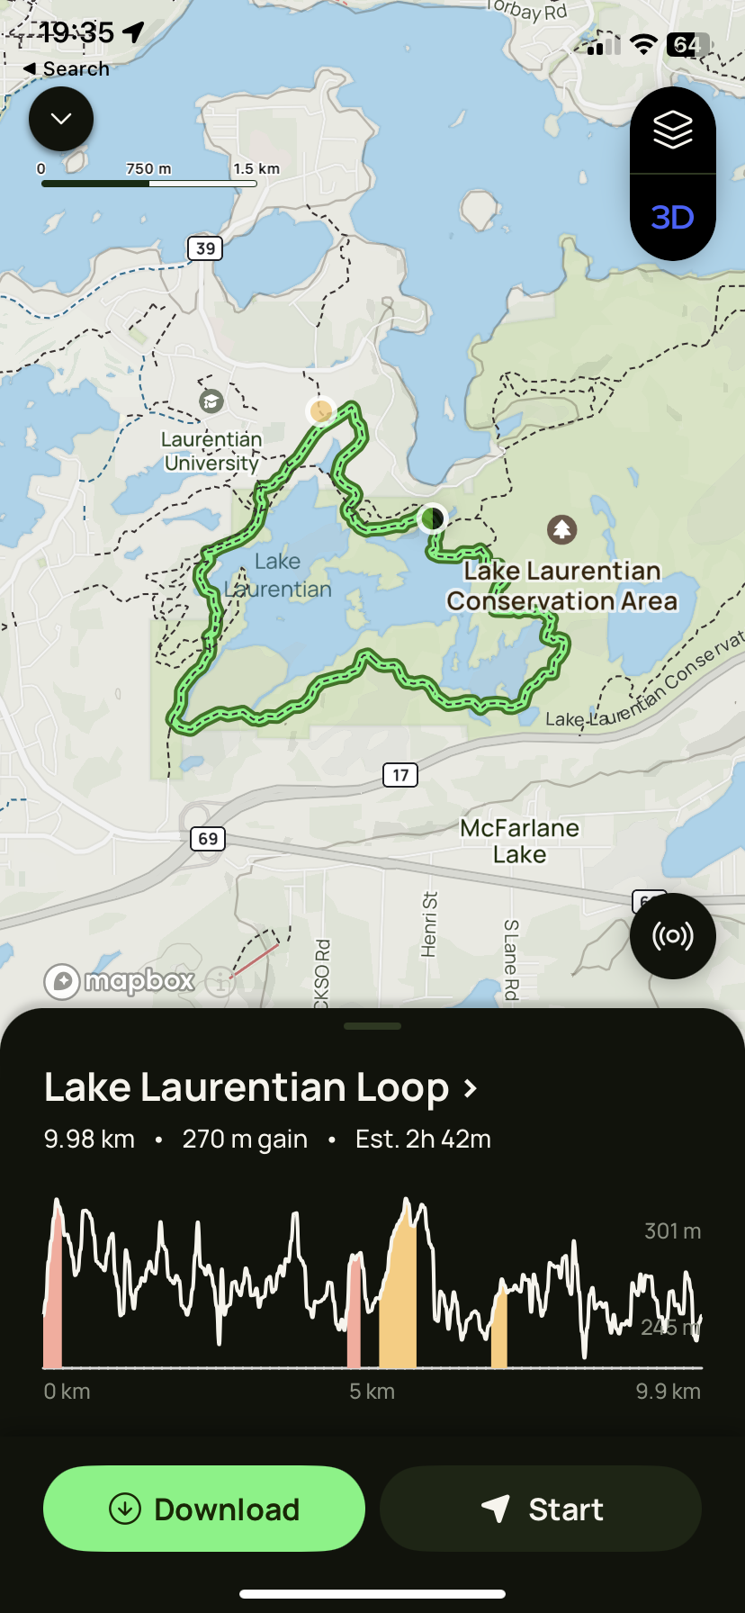
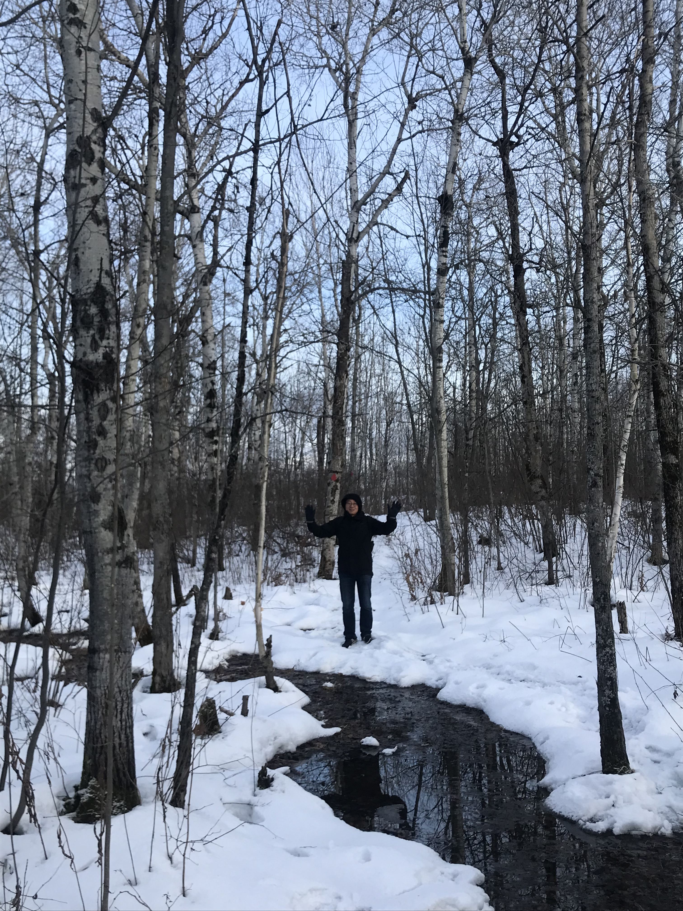

Team
Wei Zhang
William Wang

Slide 13
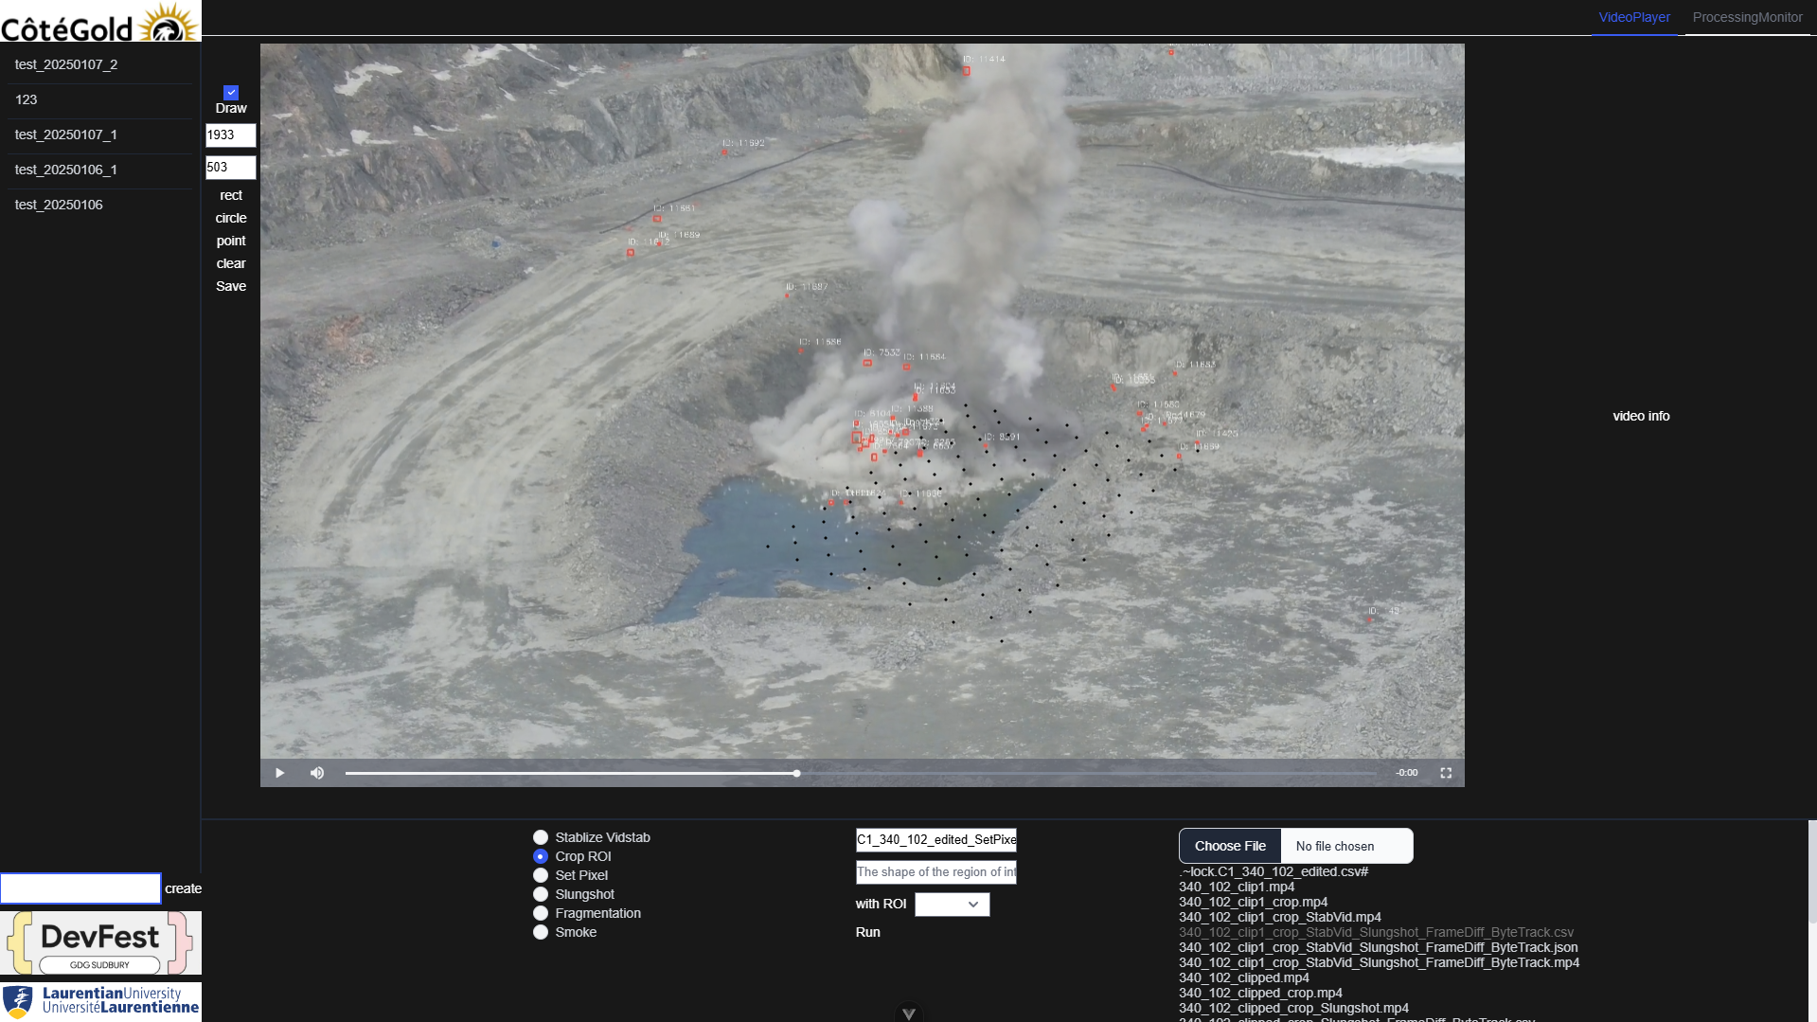
Thank you !

